Slide 1

Elderly Healthcare Management: A Comprehensive Approach
SOEN 6841 - Software Project Management
Full Name | Student ID
Abhishek Deshwal | 40220734
Sameer Kamble | 40204785
Sumit Kumar | 40254093
Ganga Singh | 40236750
Github Link https://github.com/adizero99/SPM_Group3_ElderlyHealthcareManagement

Slide 2
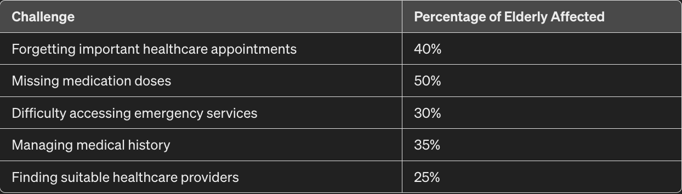
INTRODUCTION
In the face of an aging global population, elderly individuals often encounter significant challenges in managing their healthcare needs. Cognitive decline, mobility issues, and the complexity of healthcare systems contribute to problems such as missed medication doses, difficulty accessing emergency services, and managing health records. Our project aims to develop a comprehensive software solution to address these challenges, enhancing elderly care management and improving the quality of life for this demographic. By efficiently addressing these issues, we can improve health outcomes for the elderly, reduce the financial burden on families and healthcare systems, and effectively meet the growing needs of the aging population.

Slide 3
Market Analysis and Opportunity
Demographic Shifts
Unmet Needs
Emerging Technologies
The global population is aging, with an increasing proportion of individuals over the age of 65. This trend presents both challenges and opportunities for the healthcare industry.
Many elderly individuals struggle to access comprehensive, personalized healthcare services. Identifying these gaps in the market can inform the development of innovative solutions.
Advancements in telemedicine, remote monitoring, and assistive technologies can revolutionize the delivery of elderly healthcare, improving outcomes and quality of life.

Slide 4
Feasibility Assessment
1
Technical Feasibility
2
Operational Feasibility
Efficiencies through automation and real-time data analytics​​
AI-powered virtual assistants and augmented reality for remote consultations
3
Stakeholder Engagement
** The integration of wearable technology in healthcare is on the rise, with the market expected to grow to $60 billion by 2023**
Subscription services and partnerships with healthcare institutions

Slide 5
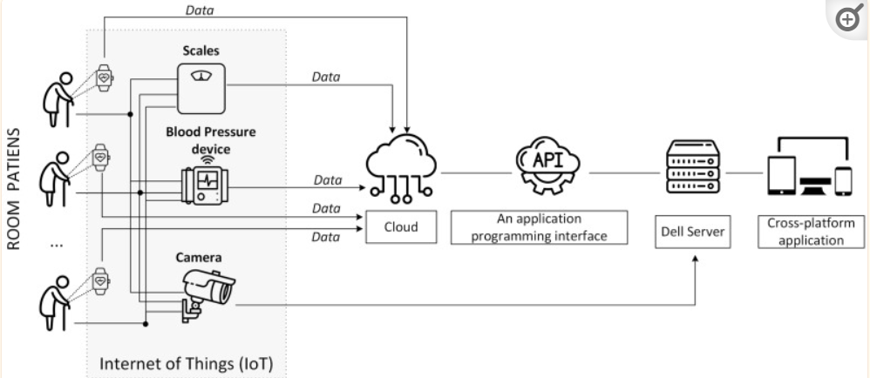

Slide 6




Risk Management
Technical Risks
The American Medical Informatics Association notes that 68% of IT professionals report scalability as a frequent challenge during health tech implementations
Operational Risk
Research by the National Institute on Aging finds that approximately 55% of elderly individuals show resistance to new technology
Economic Risk
McKinsey reports that 82% of health IT projects exceed their initial budget estimates, often significantly, due to unforeseen complexities and extended timelines

Slide 7
Risk Mitigation Strategies
Integration Complexity
User Adoption Resistance
Cost Overruns
Adopt an agile project management approach, which allows for more flexible response to changes and can help manage costs more effectively
Use API-first design to ensure that all components can communicate seamlessly with various external systems
Pilot the system with a small user group to gather insights and refine the user interface.

Slide 8
Proposed Solution
Integrated Care Model
AI-Powered Wellness Coach
Developed a comprehensive, patient-centric approach that seamlessly connects primary care, health devices such as Apple watch.
AI-powered wellness coach is more than just a reminder system. It's a proactive companion that learns from user interactions.
Blockchain-Backed Records
Holistic Health Dashboard
By decentralizing data storage and implementing cryptographic protocols, the software provides unparalleled protection against unauthorized access
By incorporating elements of emotional well-being,, and lifestyle factors, the dashboard offers a comprehensive view of the user's overall health and happiness

Slide 9
Proposed Solution
Target Audience
Virtual Assistance
According to WHO, the elderly population is projected to reach 2.1 Billion by 2050, highlighting the urgent need for innovative solutions [1].
Pilot studies have shown that such virtual assistants can improve medication adherence rates by up to 82% [2].
WHO: Elderly population Ageing and health - World Health Organization (WHO)World Health Organization (WHO)https://www.who.int › Newsroom › Fact sheets › Detail
Pilot Study: https://pubmed.ncbi.nlm.nih.gov/34831811/

Slide 10

Work Breakdown Structure
1
Planning and Design
API, Middleware, and Prototype creation
2
Technology Integration
Using Angular, NodeJS, Azure, and Jenkins (Continuous Integration) platforms to seamlessly update changes and deploy the application
3
Pilot Implementation
Test the proposed solutions in a controlled environment, Alpha, Beta release and UAT acceptance.

Slide 11
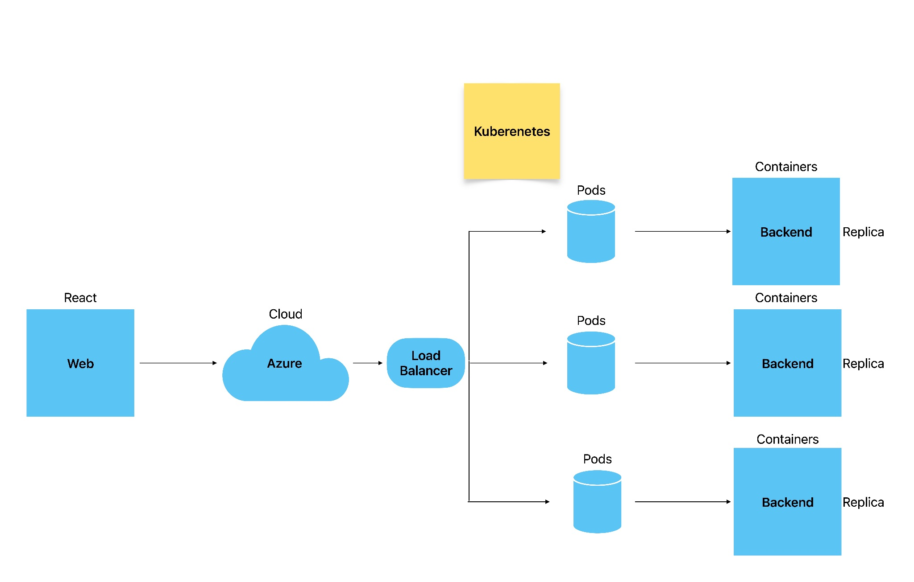
Work Breakdown Structure
1
Planning and Design

Slide 12
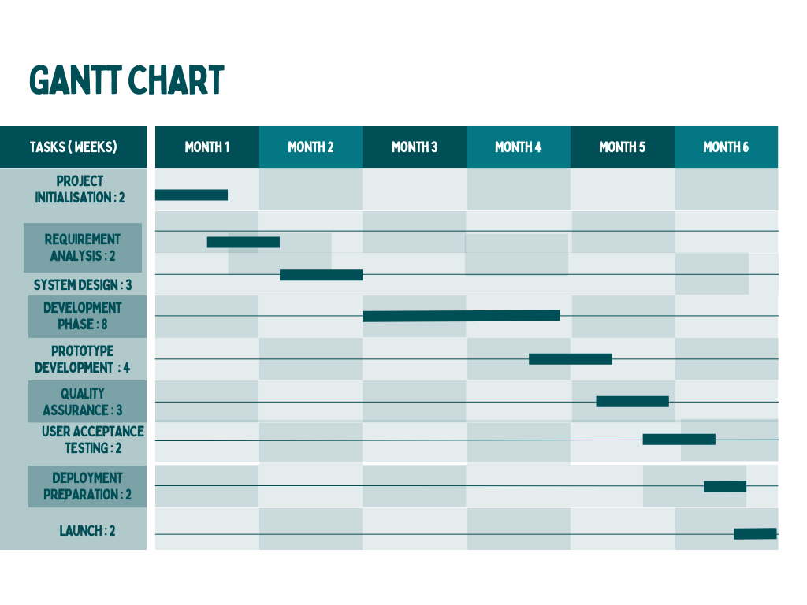
Work Breakdown Structure
1
2
3

Slide 13
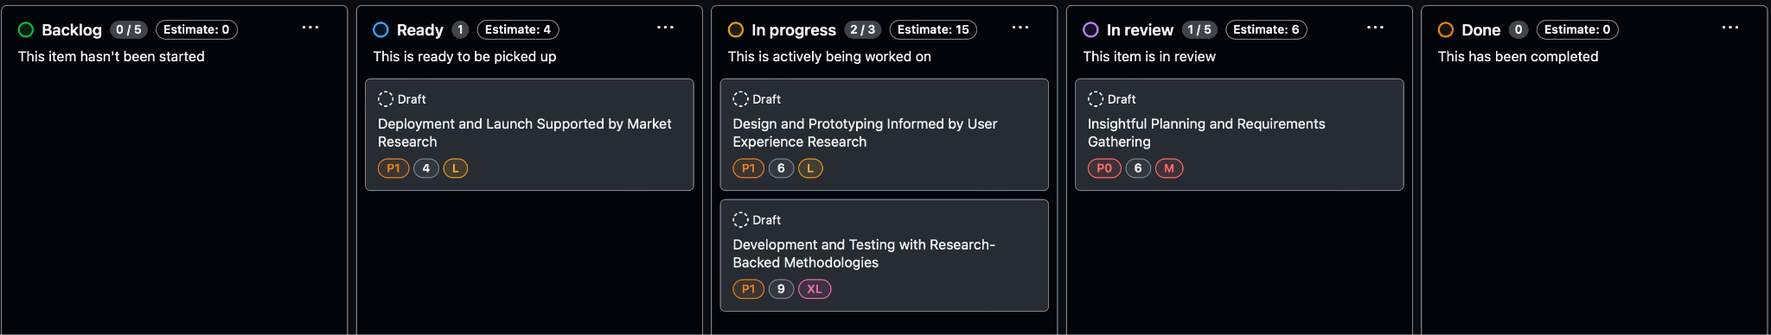
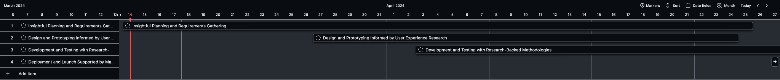
Work Breakdown Structure
1
Kanban Board
2
2
Sprint Planning

Slide 14
Budgeting and Financial Considerations
An allocated budget of $475,000 covering software development, quality assurance testing, targeted marketing strategies, and ongoing maintenance and support post-launch.
Capital Investments
Includes $335,000 for human resources, $85,000 for technology, and $100,000 for external services, covering development personnel, infrastructure, and specialized external support.
Resource Expenses
A contingency budget of 10% of the total estimated budget, amounting to $65,000, will be allocated to address unforeseen expenses, mitigate risks, and accommodate scope changes throughout the project lifecycle.
Contingency Budget

Slide 15
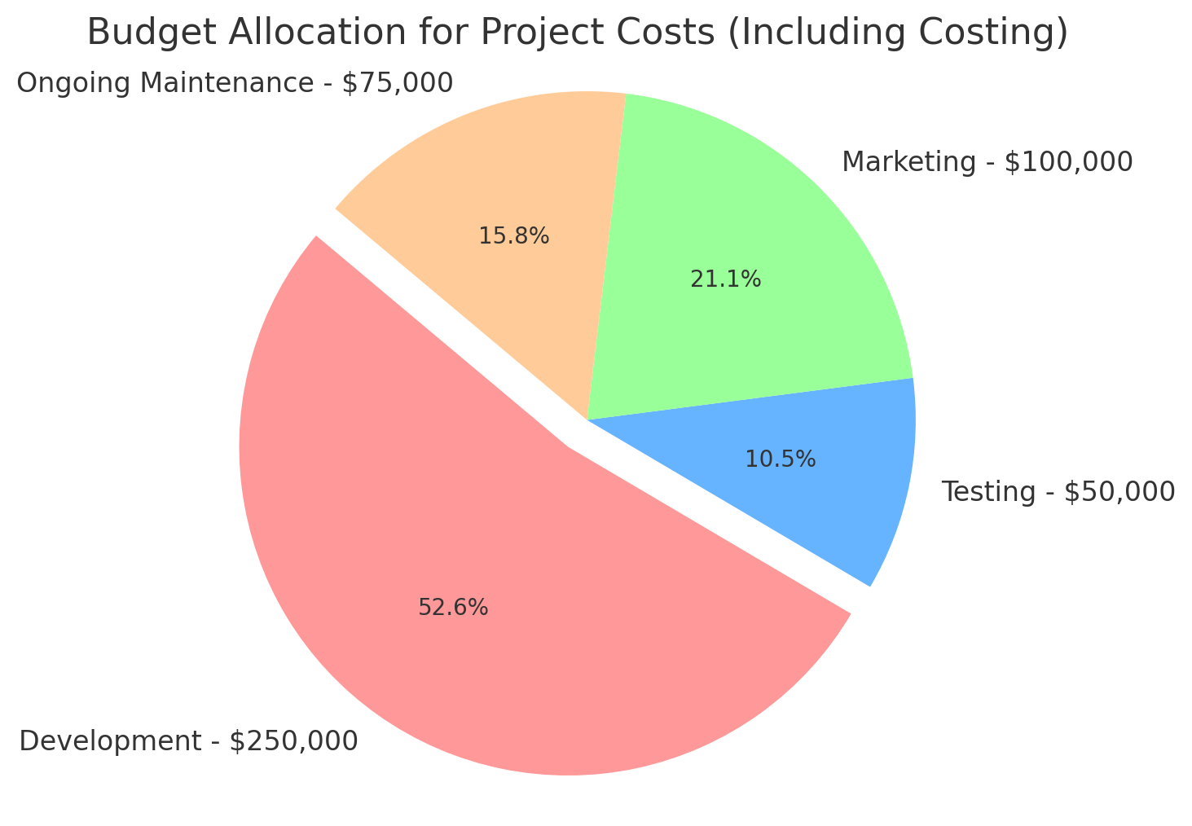
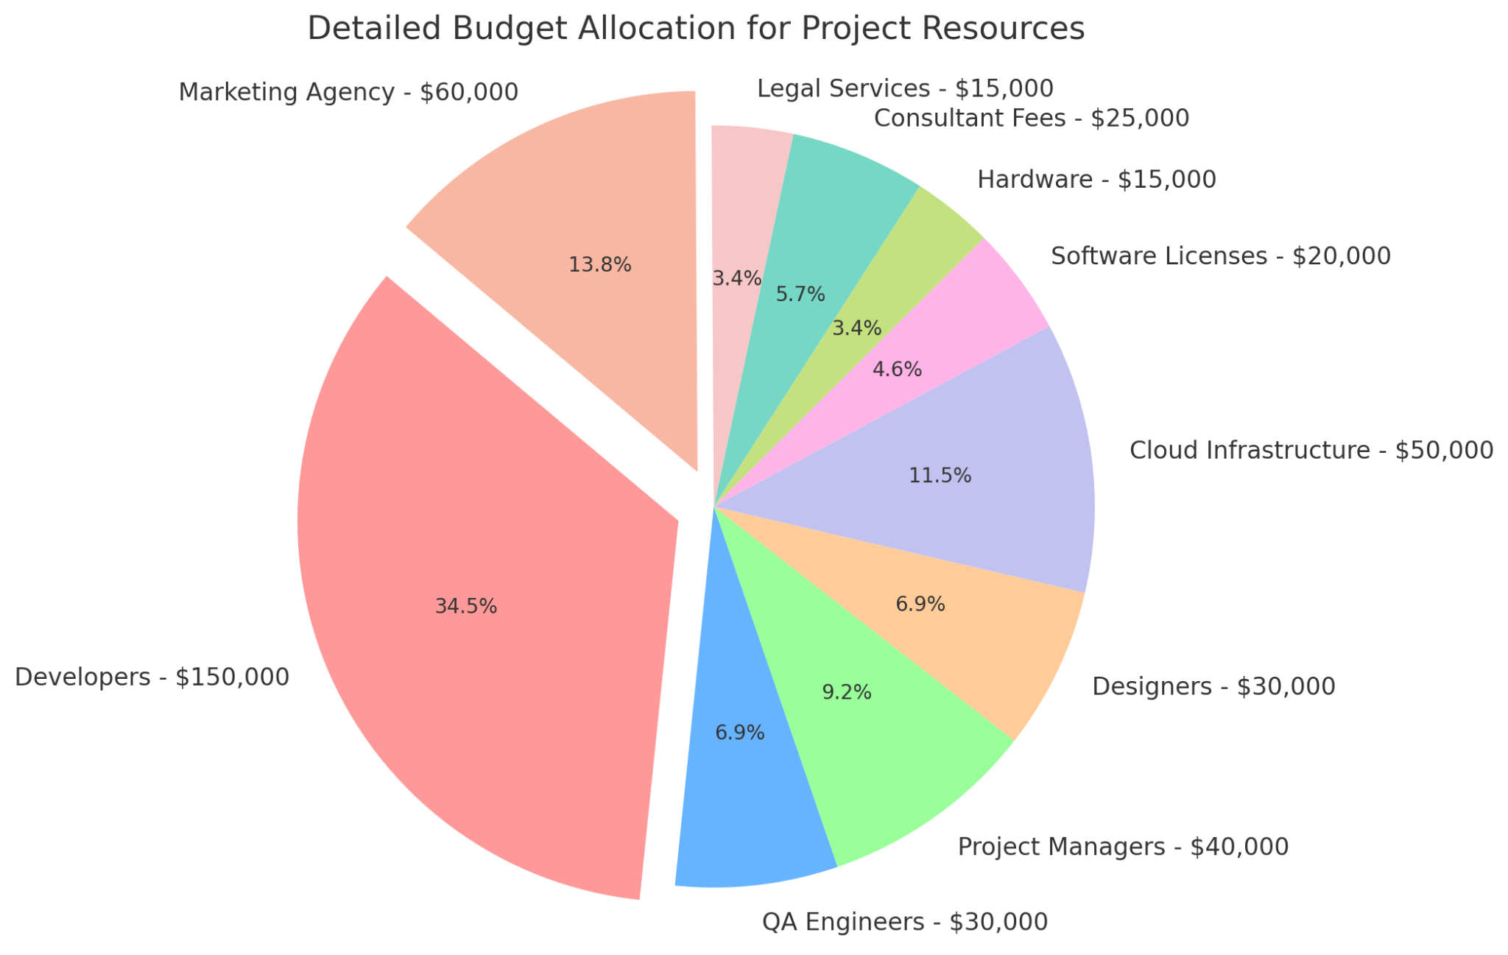

Slide 16




Conclusion and Next Steps
Stakeholder Alignment
Phased Implementation
Continuous Improvement
Capacity Building
Secure buy-in and collaboration from healthcare providers, government agencies, and community organizations.
Establish robust monitoring and evaluation processes to assess the initiative's impact and drive ongoing refinements.
Invest in the training and development of healthcare professionals to ensure the long-term sustainability of the program.
Develop a detailed timeline and roadmap for the progressive roll-out of the proposed solutions.

Slide 17
References
1)https://www.ncbi.nlm.nih.gov/pmc/articles/PMC6398972/#:~:text=Proactive%20management%20of%20risk%20requires,or%20more%20things%20or%20possibilities%E2%80%9D.
2)https://www.ncbi.nlm.nih.gov/pmc/articles/PMC10138364/

